Slide 1


Software testing
Andrei Toader

Slide 2
scope
Intent:
Is the activity to check is the software we are about to deliver is “Defect” free.
Evaluate the software and check if the actual results match the expected results.

Slide 3
Categories
Typically testing is classified in three basic categories:
Functional testing
Non-functional testing
Maintenance

Slide 4
Functional testing
Unit testing
Integration testing (smoke testing)
UAT (User acceptance testing)
Etc…

Slide 5
Non-functional testing
Performance
Load
Scalability
Usability
Etc…

Slide 6
Maintenance testing
Regression
Maintenance

Slide 7

unit testing
Manual / Automated
Unit testing relies on mock objects being created to test sections of code that are not yet part of a complete application. They fill the missing parts of the program.

Slide 8
Test driven development (TDD)
A software development process that relies on the repetition of a very short development cycle:
First you write failing test cases that define a new function/behavior.
Write the code to make the tests pass.
Refactor the code to meet the acceptable standard.

Slide 9
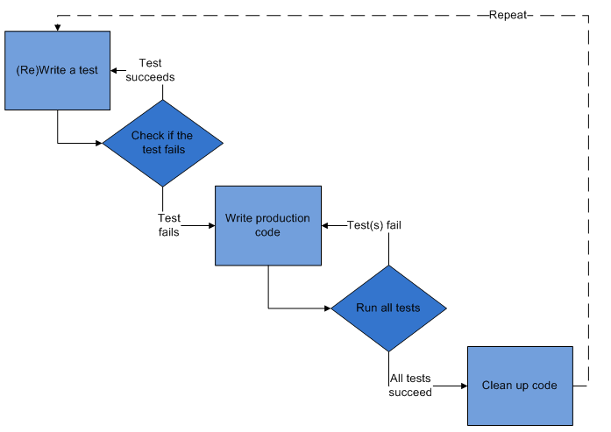
Test driven development (TDD)

Slide 10
Application under test (AUT)
Black box testing
White box testing
Grey box testing

Slide 11
Test scenarios
Creating test scenarios ensures complete test coverage for AUT.
Test scenarios include multiple test cases.
Each test scenario should be tied to a minimum of one Requirement/User story.

Slide 12
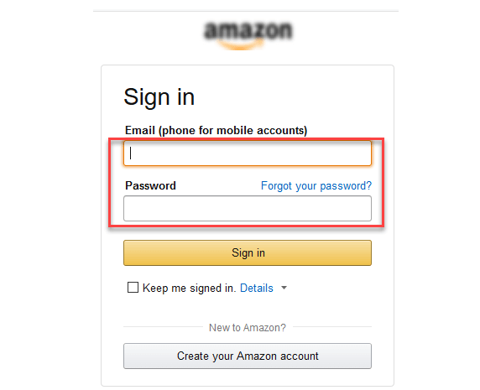
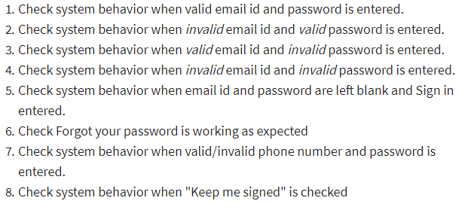
Test scenarios
Test scenarios example
Check the login functionality:

Slide 13
Known testing frameworks
Junit
Selenium
Gtest, CPPUnit, Boost.Test
Etc…

Slide 14
Internal development/testing process
For “Unit tests” we use TSE’s, which are created by the development team.
The report showing what was run for each delivery is done by Integration team.
System integration test(smoke tests) are covered by Integration team.
A quality report for the specific build is created and completed with the results of the tests.
After all the “smoke tests” have PASSED and the build is validated, this will be delivered to SystemTest team and they will do “black box” testing.
After the SystemTest validates the build, this will be delivered to the client for UAT(User acceptance testing).

Slide 15
Independent third-party tools
Static code analyzer
Performance analyzer
Blackduck, lint, codesonar

Slide 16
THANK YOU

